Slide 1
Introduction To transportation
Beiyu Lin

Slide 2
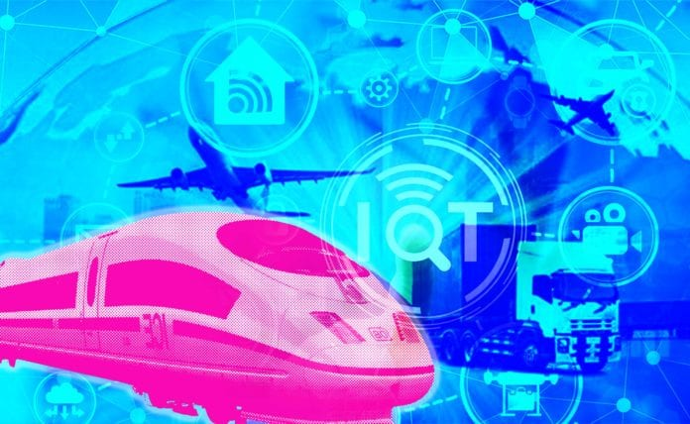
How iOT improves transportation
Assisted Driving
Dynamic Navigation
Optimized Maintenance
Expanded Ridesharing
Fleet Management

Slide 3
Why iot in transportation
The connected car market grew by 45% between 2018 and 2019 alone, with global shipments expected to pass 76 million units by 2023
It won’t be too long before connected cars are the norm. When this shift does happen, roads will be a safer and more convenient place for everyone.

Slide 4
iOT in transportation
Assisted Driving
Dynamic Navigation
Optimized Maintenance
Expanded Ridesharing
Fleet Management

Slide 5
Assisted Driving
Definition:
Driver assistance, also known as advanced driver-assistance systems (ADAS), are technologies used to make motor vehicle travel safer by automating, improving or adapting some or all of the tasks involved in operating a vehicle (link 1:04-2:10).

Slide 6
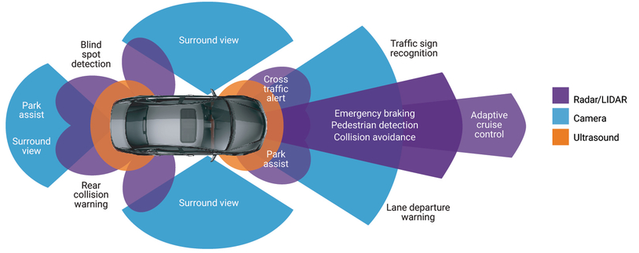
Assisted Driving

Slide 7
ASSISTED DRIVING
Challenges:
Technical: can be improved with new technologies, such as AI and machine learning
Ethical: hard to resolve
Example: difficult situations like occupant vs. pedestrian safety – moral questions
Current work:
Google partnership with General Motors and Ford
MIT’s Moral Machine

Slide 8
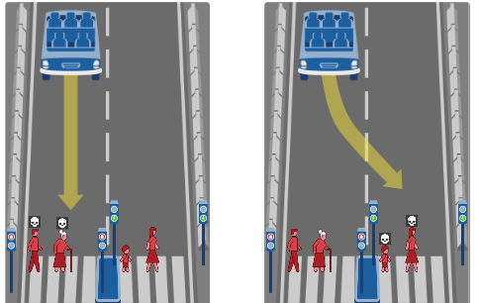
ASSISTED DRIVING
Ethical Dilemma:
What self driving car should do?
Ethical Dilemma in other fields?

Slide 9
ASSISTED DRIVING
Current methods:
Deep reinforcement learning (link)
Imitation learning (link 0:37-)

Slide 10
iOT in transportation
Assisted Driving
Dynamic Navigation
Optimized Maintenance
Expanded Ridesharing
Fleet Management

Slide 11
Dynamic Navigation
The improved navigation offered by IoT is useful to human drivers, too. Many people rely on GPS navigation, and IoT devices in vehicles could make these systems more helpful. Cross-car communication would allow navigation systems to account for real-time changes, like blockages or traffic jams.
Why not GPS?
Slow to adapt to traffic changes
IoT navigation offers real-time feedback.
Dynamic navigation (link 3:06 – 3:29 )

Slide 12
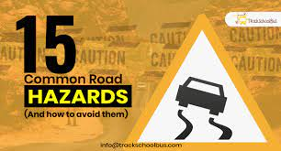
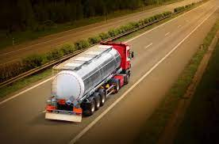
Why Dynamic Navigation
Examples
Hazards along a route can change in an instant
=> need dynamic navigation to avoid them
Examples
Environmental waste transport
=> need dynamic navigation to avoid them

Slide 13
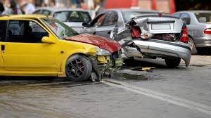
Dynamic Navigation
Examples
Traffic accidents
=> avoid risky traffic situations
IoT navigation can help them steer clear of congested areas or spots with high accident rates.

Slide 14
Dynamic Navigation
Current methods:
Deep Reinforcement Learning Dynamic Routing for Navigation (link 7:13 – 7:52 )
DRL: single targe and multi-target agent (link 4:51- 5:23)
LiDAR data (link 0:42 – 2:58)

Slide 15
iOT in transportation
Assisted Driving
Dynamic Navigation
Optimized Maintenance
Expanded Ridesharing
Fleet Management

Slide 16
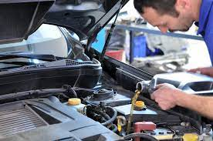
Optimized Maintenance
When should we change the oil?
How could we know when to do frequent vehicle maintenance?
IoT can help
Example (link: 0:04-1:08)

Slide 17
Optimized Maintenance
Current methods
Neural Network Classification (link 0.06- 0:13)
Sensor based (link: 0.54- 1:43)

Slide 18
iOT in transportation
Assisted Driving
Dynamic Navigation
Optimized Maintenance
Expanded Ridesharing
Fleet Management

Slide 19
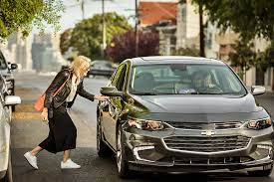
Expanded Ridesharing
Why Ridesharing is good?
able to transport people to and from anywhere
reducing traffic congestion and parking demand
eliminate vehicle emissions and creates less stressful commutes
How IoT helps?

Slide 20

Expanded Ridesharing
What are the problems of ridesharing?
Safety of rider and driver
Possible solutions: phone vibration study

Slide 21
Expanded Ridesharing
What are the problems of ridesharing?
Fairness (rural area has no cars to pick up customers)
Reward based reinforcement learning method

Slide 22
iOT in transportation
Assisted Driving
Dynamic Navigation
Optimized Maintenance
Expanded Ridesharing
Fleet Management

Slide 23

Fleet Management
An IoT-enabled fleet management solution helps businesses gain competitive advantages by automating processes in a cloud-based platform and providing real-time visibility into everything that goes on in the field.

Slide 24
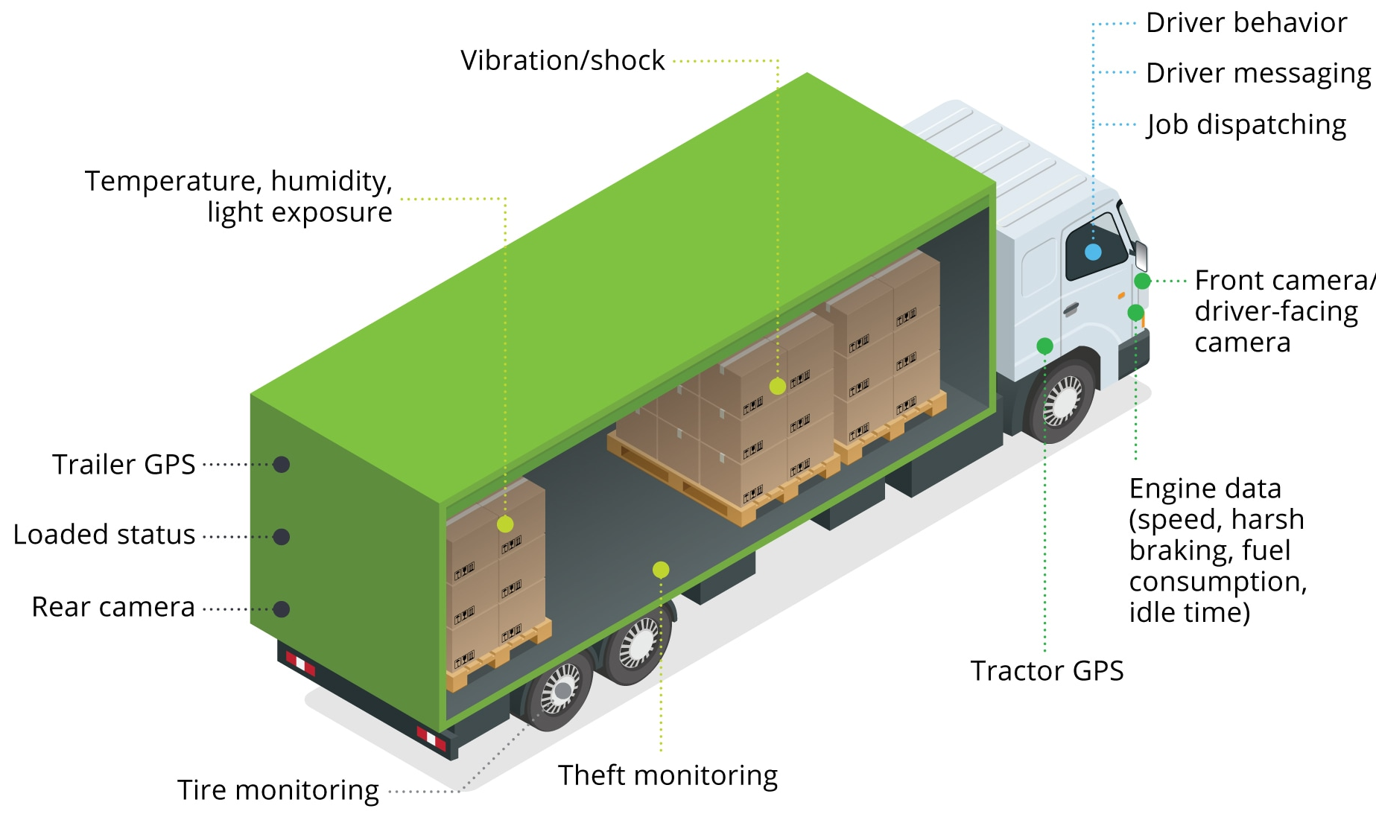
Fleet Management
Examples:
1. UPS collects GPS & IoT sensor
to minimize the number of fixes
2. Drivers’ driving habits:
Aggressive or not
3. Inventory and warehouse management
4. Supply chain management

Slide 25
Fleet Management
Possible topics:
Supply chain shortage
Security and Privacy

Slide 26
Algorithms
Reinforcement Learning

Slide 27
Previous Lectures
Supervised learning
classification, regression
Unsupervised learning
clustering
Reinforcement learning
more general than supervised/unsupervised learning
learn from interaction w/ environment to achieve a goal
environment
reward
new state
action
agent

Slide 28
Today
examples
defining an RL problem
Markov Decision Processes
solving an RL problem
Dynamic Programming
Monte Carlo methods
Temporal-Difference learning

Slide 29
Robot in a room
 |  |  | +1
 |  |  | -1
START
actions: UP, DOWN, LEFT, RIGHT
UP
80% move UP
10% move LEFT
10% move RIGHT
reward +1 at [4,3], -1 at [4,2]
reward -0.04 for each step
what’s the strategy to achieve max reward?
what if the actions were deterministic?
Notes:
want to learn a policy (what’s the solution?)
can we learn it using (un)supervised learning? why not?
so how do we learn it? any ideas?
let the robot explore the environment

Slide 30
Other examples
CarPole-balancing (simulate using open AI Gym)
no teacher who would say “good” or “bad”
is reward “10” good or bad?
rewards could be delayed
similar to control theory
more general, fewer constraints
explore the environment and learn from experience
not just blind search, try to be smart about it

Slide 31
Outline
examples
Markov Decision Processes
solving an RL problem
Dynamic Programming
Monte Carlo methods
Temporal-Difference learning

Slide 32
Robot in a room
 |  |  | +1
 |  |  | -1
START
actions: UP, DOWN, LEFT, RIGHT
UP
80% move UP
10% move LEFT
10% move RIGHT
reward +1 at [4,3], -1 at [4,2]
reward -0.04 for each step
states
actions
Rewards
what is the solution?
Notes:
want to learn a policy (what’s the solution?)
can we learn it using (un)supervised learning? why not?
so how do we learn it? any ideas?
let the robot explore the environment

Slide 33
Is this a solution?
only if actions deterministic
not in this case (actions are stochastic)
solution/policy
mapping from each state to an action
 |  |  | +1
 |  |  | -1

Slide 34
Markov Decision Process (MDP)
set of states S, set of actions A, initial state S₀
transition model P(s,a,s’)
P( [1,1], up, [1,2] ) = 0.8
reward function r(s)
r( [4,3] ) = +1
goal: maximize cumulative reward in the long run
policy: mapping from S to A
π(s) or π(s,a) (deterministic vs. stochastic)
reinforcement learning
transitions and rewards usually not available
how to change the policy based on experience
how to explore the environment
environment
reward
new state
action
agent

Slide 35
Computing return from rewards
episodic (vs. continuing) tasks
“game over” after N steps
optimal policy depends on N; harder to analyze
additive rewards
V(s₀, s₁, …) = r(s₀) + r(s₁) + r(s₂) + …
infinite value for continuing tasks
discounted rewards
V(s₀, s₁, …) = r(s₀) + γ*r(s₁) + γ²*r(s₂) + …
value bounded if rewards bounded

Slide 36
Discounted Rewards
Rewards in the future are worth less than an immediate reward
Because of uncertainty: who knows if/when you’re going to get to that reward state
Notes:
Sum to inf

Slide 37
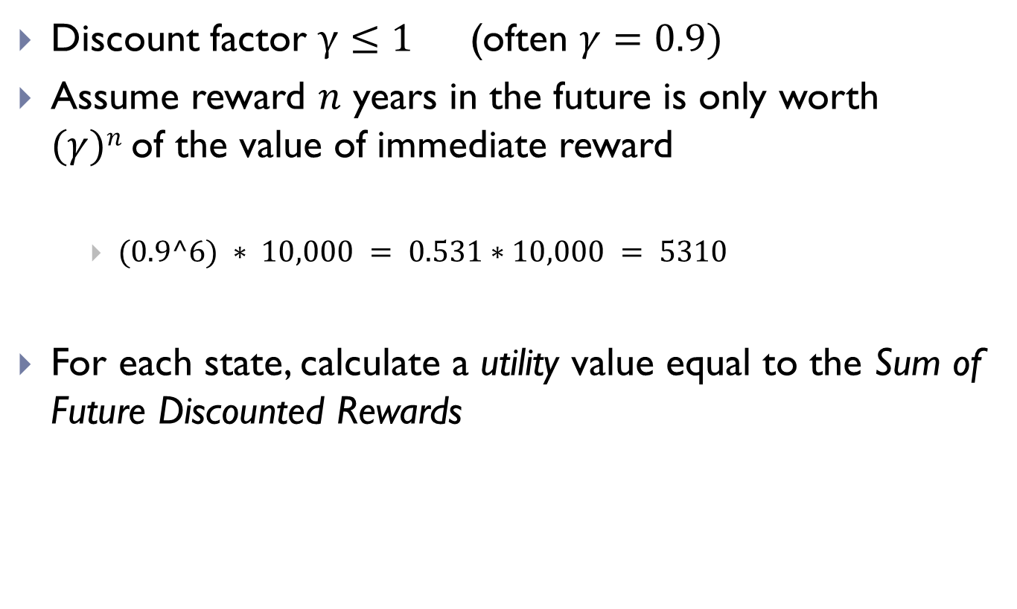
Discounted Rewards
Discount factor $γ≤1$ (often $γ=0.9)$
Assume reward $n$ years in the future is only worth $(γ)n$of the value of immediate reward
$(0.9^6) ∗ 10,000 = 0.531∗10,000 = 5310$
For each state, calculate a utility value equal to the Sum of Future Discounted Rewards

Slide 38
Value functions
state value function: V^{π}(s)
expected return when starting in s and following π
state-action value function: Q^{π}(s,a)
expected return when starting in s, performing a, and following π
useful for finding the optimal policy
can estimate from experience
pick the best action using Q^{π}(s,a)
Bellman equation
s
a
r
s’

Slide 39
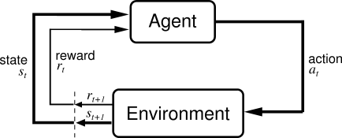
Reinforcement Learning
Basic idea:
Receive feedback in the form of rewards
Agent’s utility is defined by the reward function
Must (learn to) act so as to maximize expected rewards

Slide 40
Reinforcement Learning (RL)
RL algorithms attempt to find a policy for maximizing cumulative reward for the agent over the course of the problem.
Typically represented by a Markov Decision Process
RL differs from supervised learning in that correct input/output pairs are never presented, nor sub-optimal actions explicitly corrected.

Slide 41


What is Markov about MDPs?
Andrey Markov (1856-1922)
“Markov” generally means that given the present state, the future and the past are independent
For Markov decision processes, “Markov” means:

Slide 42
Solving MDPs
In deterministic single-agent search problems, want an optimal plan, or sequence of actions, from start to a goal
In an MDP, we want an optimal policy π*: S → A
A policy π gives an action for each state
An optimal policy maximizes expected utility if followed
Defines a reflex agent
Optimal policy when R(s, a, s’) = -0.03 for all non-terminals s

Slide 43
Recap: Defining MDPs
s
Markov decision processes:
States S
Start state s₀
Actions A
Transitions P(s’|s,a) (or T(s,a,s’))
Rewards R(s,a,s’) (and discount γ)
MDP quantities so far:
Policy = Choice of action for each state
Utility (or return) = sum of discounted rewards
a
s, a
s,a,s’
s’

Slide 44
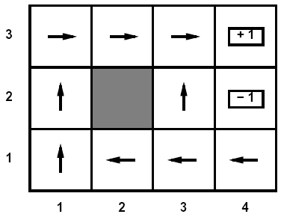
Optimal Utilities
Fundamental operation: compute the values (optimal expect max utilities) of states s
Why? Optimal values define optimal policies!
Define the value of a state s:
V*(s) = expected utility starting in s and acting optimally
Define the value of a q-state (s,a):
Q*(s,a) = expected utility starting in s, taking action a and thereafter acting optimally
Define the optimal policy:
π*(s) = optimal action from state s
s
a
s, a
s,a,s’
s’

Slide 45
Value Iteration
Idea:
Start with V₀*(s) = 0, which we know is right (why?)
Given V_{i}*, calculate the values for all states for depth i+1:
This is called a value update or Bellman update
Repeat until convergence
Theorem: will converge to unique optimal values
Basic idea: approximations get refined towards optimal values
Policy may converge long before values do

Slide 46
iOT in transportation
Assisted Driving
Dynamic Navigation
Optimized Maintenance
Expanded Ridesharing
Fleet Management

Slide 47
Fleet Management
Examples:
1. UPS collects GPS & IoT sensor
to minimize the number of fixes
2. Drivers’ driving habits:
Aggressive or not
3. Inventory and warehouse management
4. Supply chain management

Slide 48
Previous Lectures
Supervised learning
classification, regression
Unsupervised learning
clustering
Reinforcement learning
more general than supervised/unsupervised learning
learn from interaction w/ environment to achieve a goal
environment
reward
new state
action
agent

Slide 49
Outline
examples
Markov Decision Processes
solving an RL problem
Dynamic Programming
Monte Carlo methods
Temporal-Difference learning

Slide 50
Markov Decision Process (MDP)
set of states S, set of actions A, initial state S₀
transition model P(s,a,s’)
P( [1,1], up, [1,2] ) = 0.8
reward function r(s)
r( [4,3] ) = +1
goal: maximize cumulative reward in the long run
policy: mapping from S to A
π(s) or π(s,a) (deterministic vs. stochastic)
reinforcement learning
transitions and rewards usually not available
how to change the policy based on experience
how to explore the environment
environment
reward
new state
action
agent

Slide 51
Outline
examples
Markov Decision Processes
Reinforcement learning

Slide 52
Reinforcement Learning
Reinforcement learning:
Still assume an MDP:
A set of states s ∈ S
A set of actions (per state) A
A model T(s,a,s’)
A reward function R(s,a,s’)
A discount factor γ (could be 1)
Still looking for a policy π(s)
New twist: don’t know T or R
i.e. don’t know which states are good or what the actions do
Must actually try actions and states out to learn

Slide 53
The Story So Far: MDPs and RL
Things we know how to do:
Techniques:
If we know the MDP
Compute V*, Q*, π* exactly
Evaluate a fixed policy π
If we don’t know the MDP
We can estimate the MDP then solve
We can estimate V for a fixed policy π
We can estimate Q*(s,a) for the optimal policy while executing an exploration policy
Model-based DPs
Value and policy Iteration
Policy evaluation
Model-based RL
Model-free RL:
Value learning
Q-learning

Slide 54
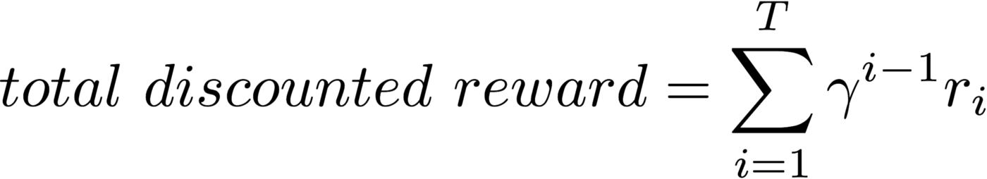
VALUE FUNCTION
where T is the horizon (episode length) which can be infinity if there is maximum length for the episode.

Slide 55
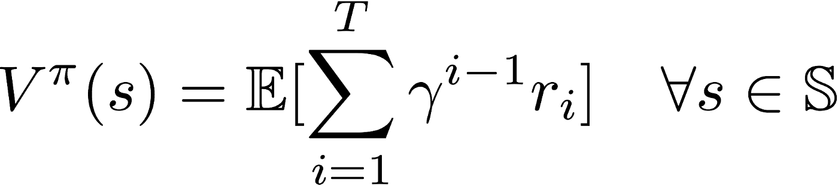
Model-based rl: Value-iteration
The value function represent how good is a state for an agent to be in.
It is equal to expected total reward for an agent starting from state s.
The value function depends on the policy by which the agent picks actions to perform.
if the agent uses a given policy 𝛑 to select actions, the corresponding value function is given by

Slide 56
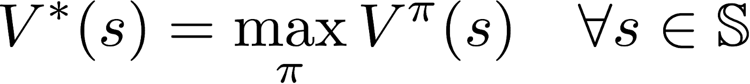
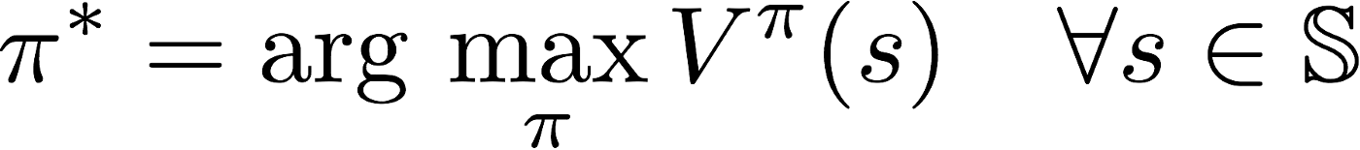
Model-based rl: Value-iteration
Among all possible value-functions, there exist an optimal value function that has higher value than other functions for all states.
The optimal policy 𝛑* is the policy that corresponds to optimal value function.

Slide 57

Q-function
Q is a function of a state-action pair and returns a real value.
The optimal Q-function Q*(s, a) means:
the expected total reward received by an agent starting in s and picks action a, then will behave optimally afterwards.
There, Q*(s, a) is an indication for how good it is for an agent to pick action a while being in state s.

Slide 58
Model-based rl: Value-iteration
Among all possible value-functions, there exist an optimal value function that has higher value than other functions for all states.

Slide 59
Model-based rl: Value-iteration
If we know the optimal Q-function Q*(s, a) , the optimal policy can be easily extracted by choosing the action a that gives maximum Q*(s, a) for state s

Slide 60
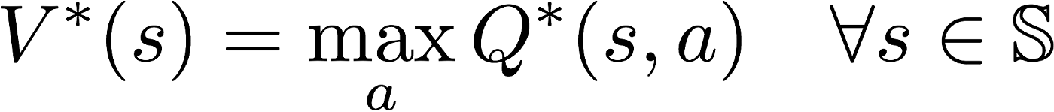
Model-based rl: Value-iteration
Since V*(s) is the maximum expected total reward when starting from state s , it will be the maximum of Q*(s, a)over all possible actions.
Therefore, the relationship between Q*(s, a) and V*(s) is easily obtained as:

Slide 61
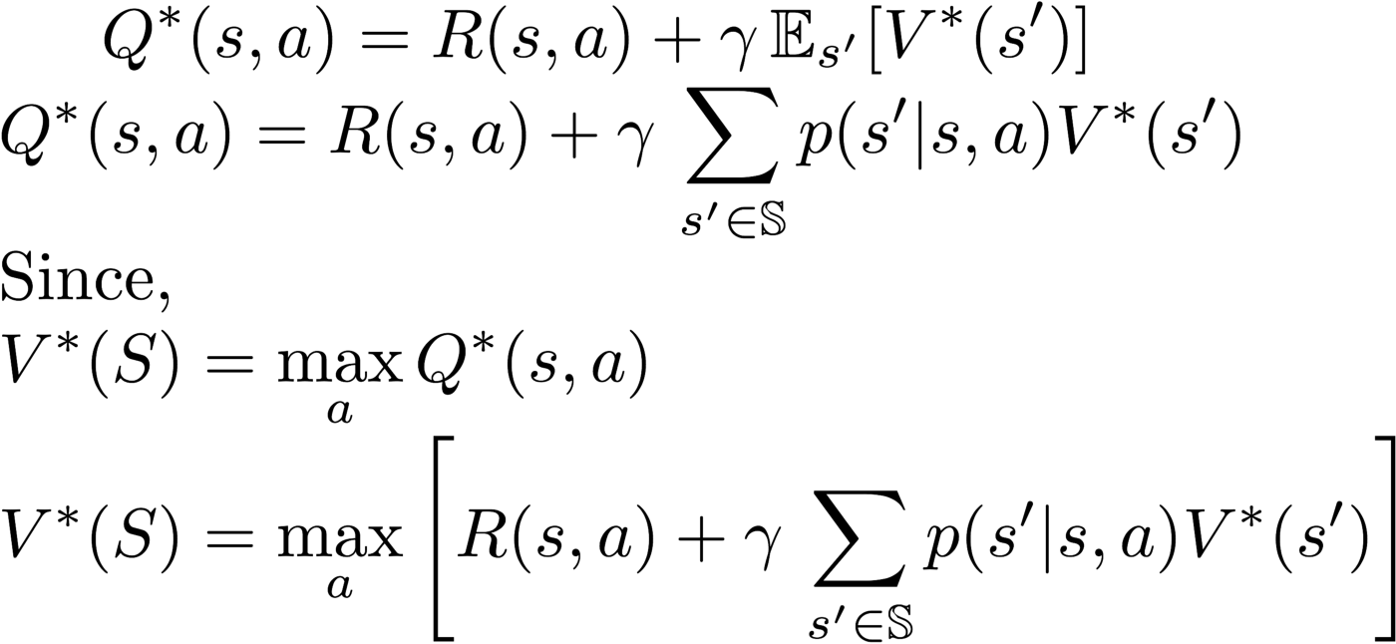
Model-based rl: Value-iteration
Bellman equation: using dynamic programming paradigm provides a recursive definition for the optimal Q-function.
The Q*(s, a) is equal to the summation of immediate reward after performing action a while in state s and the discounted expected future reward after transition to a next state s'

Slide 62
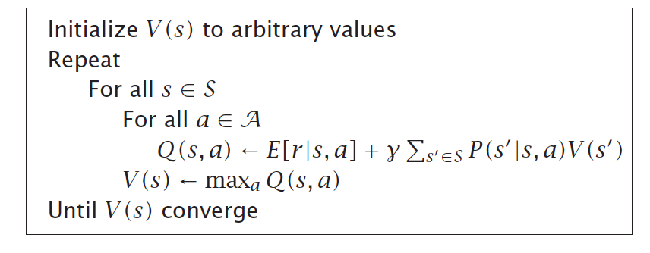
Model-based rl: Value-iteration
Value iteration computes the optimal state value function by iteratively improving the estimate of V(s). The algorithm:
1). initialize V(s) to arbitrary random values.
2). it repeatedly updates the Q(s, a) and V(s) values until they converges.
3). value iteration is guaranteed to converge to the optimal values.

Slide 63
Model-based rl: Value-iteration
Example: Froze Lake on a 8x8 grid using value-iteration

Slide 64
Model-based rl: Policy-iteration
Since the agent only cares about the finding the optimal policy, sometimes the optimal policy will converge before the value function.
policy-iteration: re-define the policy at each step and compute the value according to this new policy until the policy converges.
Policy iteration is also guaranteed to converge to the optimal policy and it often takes less iterations to converge than the value-iteration algorithm.

Slide 65
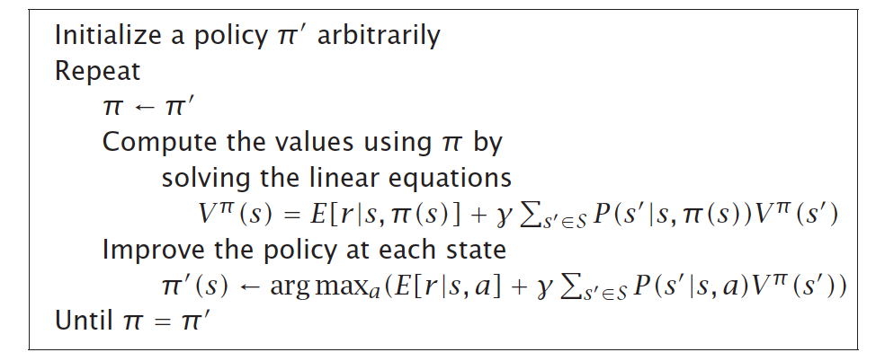
Model-based rl: Policy-iteration
Since the agent only cares about the finding the optimal policy, sometimes the optimal policy will converge before the value function.

Slide 66
Model-based rl: POLICY-iteration
Example: Froze Lake on a 8x8 grid using value-iteration

Slide 67
Model-free rl: Q-LEARNING
Unknown: state transition and reward models
Known: the set of possible states and actions, and current state
Solution: learn through the experience of interactions with the environment.
Q-learning: will not try to learn explicit models of the environment state transition and reward functions. However, it: 1) directly derives an optimal policy from the interactions with the environment;
2) the agent will discover what are the good and bad actions by trial and error.

Slide 68
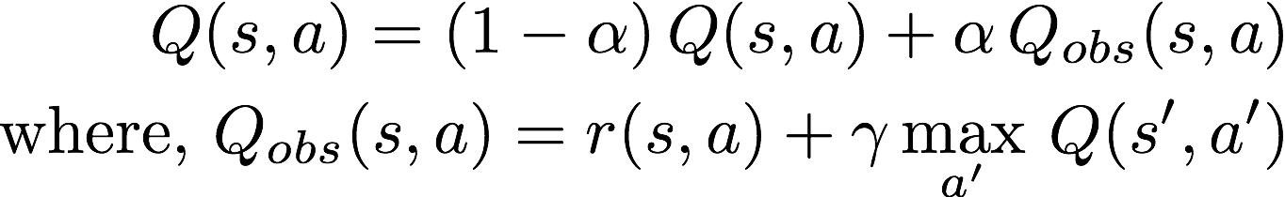
Model-free rl: Q-LEARNING
The basic idea:
approximate the state-action pairs Q-function from the samples of Q(s, a) that we observe during interaction with the environment --- Time-Difference Learning.
where 𝛂 is the learning rate. The Q(s,a) where 𝛂 is the learning rate. The Q(s,a)table is initialized randomly table is initialized randomly

Slide 69
Model-free rl: Q-LEARNING
Exploration vs exploitation:
how does the agent select actions during learning?
Should the agent trust the learnt values of Q(s, a) enough to select actions based on it ? or try other actions hoping this may give it a better reward. This is known as the exploration vs exploitation dilemma

Slide 70
exploration vs exploitation dilemma
𝛆-greedy approach where at each step:
1). Given a small probability 𝛜, the agent will pick a random action (explore)
or
2). Given a probability (1-𝛜) the agent will select an action according to the current estimate of Q-values.
𝛜 value can be decreased overtime as the agent becomes more confident with its estimate of Q-values.

Slide 71
INVERSE REINFORCEMENT LEARNING

Slide 72
Imitation Learning
Two approaches:
Behavioral cloning
A supervised learning problem that maps state/action pairs to policy (State: feature, action: label)
Requires a large number of expert trajectories (high sample complexity) - due to compounding error caused by covariate shift
Copies unnecessary actions as well
Inverse reinforcement learning
Learns the reward function from expert trajectories that prioritizes entire trajectories over others, then derives the optimal policy
Expensive to run (Inner loop has RL)
Indirectly learns optimal policy from the reward function (Using RL)

Slide 73
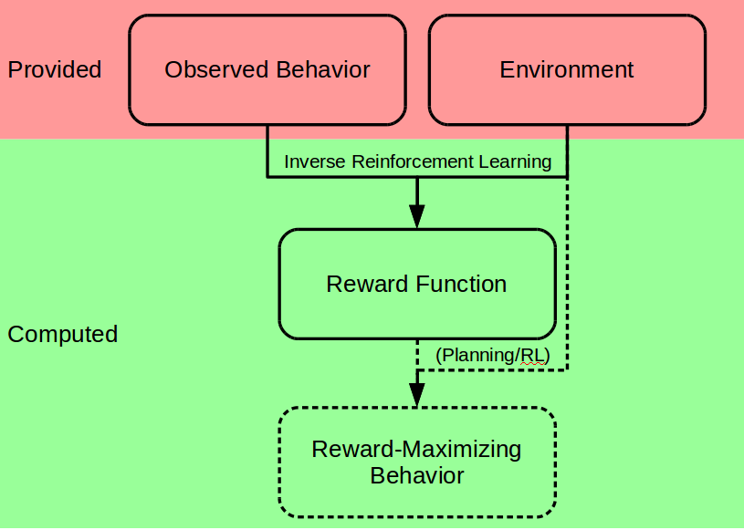
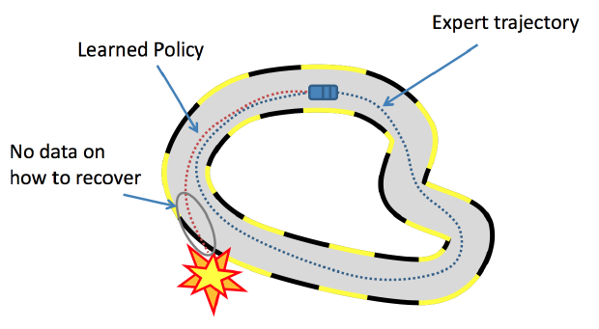
imitation LEARNING
Behavioral Cloning (BC)
Inverse reinforcement learning (IRL)

Slide 74
Generative adversarial imitation learning
Directly extracting a policy from data as if it were obtained by RL following IRL.
Bypassing any intermediate IRL step
Draws an analogy between imitation learning and generative
adversarial networks (GAN)
Derive a model-free imitation learning algorithm with significant performance improvement with low sample and computational complexity.

Slide 75
Markov Decision Process (MDP)
set of states S, set of actions A, initial state S₀
transition model P(s,a,s’)
P( [1,1], up, [1,2] ) = 0.8
reward function r(s)
r( [4,3] ) = +1
goal: maximize cumulative reward in the long run
policy: mapping from S to A
π(s) or π(s,a) (deterministic vs. stochastic)
reinforcement learning
transitions and rewards usually not available
how to change the policy based on experience
how to explore the environment
environment
reward
new state
action
agent

Slide 76
The Story So Far: MDPs and RL
Things we know how to do:
Techniques:
If we know the MDP
Compute V*, Q*, π* exactly
Evaluate a fixed policy π
If we don’t know the MDP
We can estimate the MDP then solve
We can estimate V for a fixed policy π
We can estimate Q*(s,a) for the optimal policy while executing an exploration policy
Model-based DPs
Value and policy Iteration
Policy evaluation
Model-based RL
Model-free RL:
Value learning
Q-learning

Slide 77
Papers covered
Analyzing Sensor-Based Individual and Population Behavior Patterns via Inverse Reinforcement Learning. Lin, B. and Cook, D.J., 2020. Sensors, 20(18), p.5207.
Deep PQR: Solving Inverse Reinforcement Learning using Anchor Actions Geng S, Nassif H, Manzanares C, Reppen M, and Sircar R International Conference on Machine Learning (ICML'20), Vienna, Austria, 2020.
Seeker: Real-Time Interactive Search Biswas A, Pham TT, Vogelsong M, Snyder B, and Nassif H Knowledge Discovery in Databases Conference (KDD'19), Anchorage, Alaska, pp. 2867-2875, 2019.
Notes:
First, they both leverage reward signals to inform recommendation, second, they were both led by interns.

Slide 78
Inverse Reinforcement Learning (IRL) of Indoor Behavior - Hypothesis
1. Model navigation patterns as a Markov decision process
2. Design the spatio-temporal features of indoor navigations
3. Learn a behavior strategy that is consistent with the observed movement patterns
4. Analyze behavior patterns and differences on different subgroups (eight actual smart homes)

Slide 79
Inverse Reinforcement Learning (IRL) of Indoor Behavior – RL v.s. IRL
Notes:
Unlike other IRL research, which learns from imitation to recreate expert moves, we learn from mimicry to capture and analyze a model of human behavior.
To model human behavior from ambient sensor data, we propose an approach that is based on inverse reinforcement learning (IRL).
IRL is a machine learning technique that mimics observed behavior. In this study, our proposed algorithm mimics the behavior of a smart home resident based on sensor-observed navigation patterns within a home environment.
Unlike other IRL research, which learns from imitation to recreate expert moves, we learn from mimicry to capture and analyze a model of human behavior.
Note: the significance of learning the rewards: learn the preference differences on different subgroups.

Slide 80
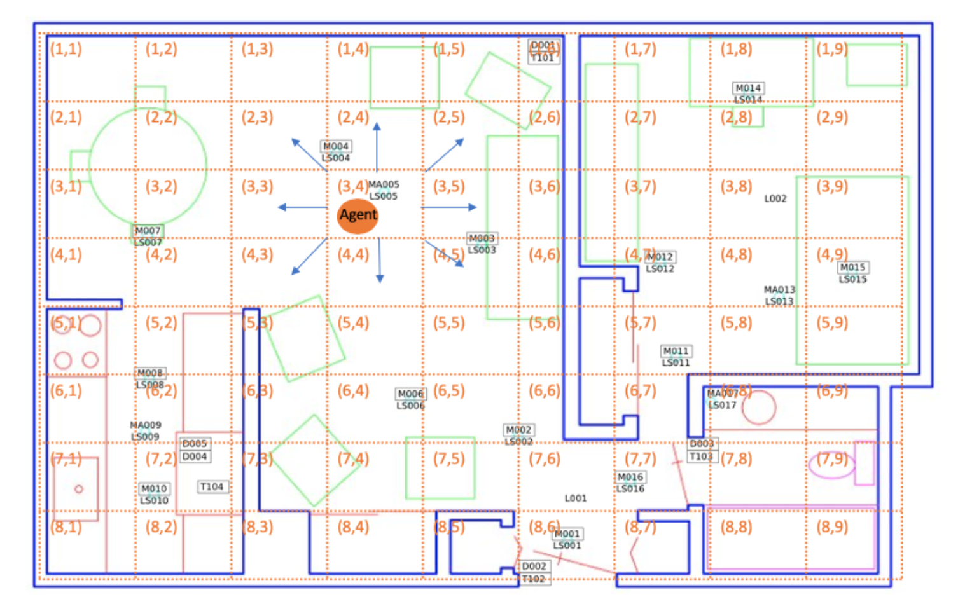
Inverse Reinforcement Learning (IRL) of Indoor Behavior – Navigation
d_toilet | d_bathroom_sink | d_livingroom_chair | d_kitchen_sink
d_bedroom | d_kitchen | d_livingroom | d_hallway
d_stove | d_office_chair | o_toilet | o_livingroom_chair
o_kitchen_sink | o_office_chair
Notes:
Table is the features:
feature names prefixed by “d : the duration that the resident stays at a location
feature names prefixed by “o_”: the overall activity/movement level at a location

Slide 81
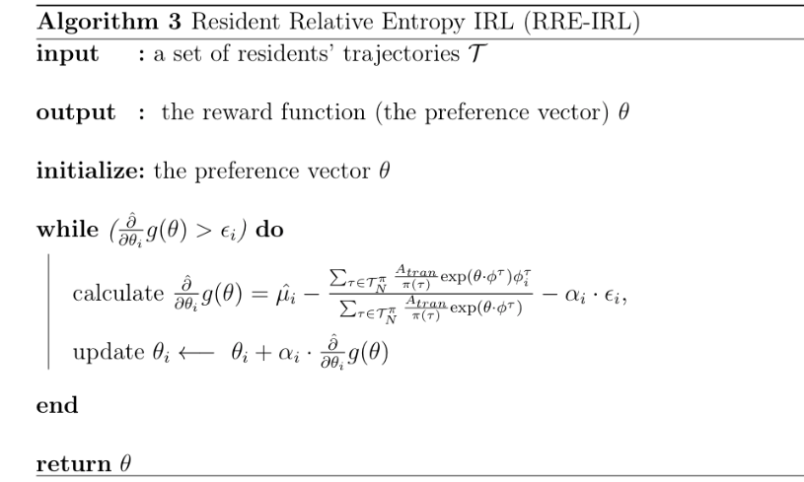
Inverse Reinforcement Learning (IRL) of Indoor Behavior – Algorithm
:
Notes:
IRL is an optimization problem. To solve it, there are two steps:
1. introducing Lagrange multipliers to have a Lagrangian
2. solving a Lagrange dual function g
Note: \hat{\partial} g(\theta) is the gradient of the dual function g.
\hat{\partial} g(\theta) : gradient estimation based on trajectories.
1. \hat{u_i}: feature expectations
2. A_tran: join probability of the actions executed on the states in trajectories.

Slide 82
Inverse Reinforcement Learning (IRL) of Indoor Behavior – Datasets
Group | ID | Health Diagnosis | #Sensors | Duration of Data Collection | Number of Month-long Samples
Cognitive decline | Home 1 | Mild Cognitive Impairment (MCI) | 21 downward-facing motion (motion); 2 motion area (ma) | 843 days | 26
 | Home 2 | MCI | 19 motion; 2 ma | 223 days | 7
 | Home 3 | MCI | 26 motion; 0 ma | 682 days | 22
 | Home 4 | MCI, Early dementia | 11 motion; 2 ma | 149 days | 5
Cognitively healthy | Home 5 | Healthy | 13 motion; 1 temperature | 1788 days | 56
 | Home 6 | Healthy | 13 motion | 1591 days | 49
 | Home 7 | Healthy | 18 motion; 2 ma | 379 days | 12
 | Home 8 | Healthy | 10 motion; 1 ma | 969 days | 31
Notes:
Talk about the purposes of the experiments. What we hope IRL is doing and what we hope to find?
We analyze movement-based behavior data collected in 8 smart homes. The table provides a summary of the eight homes.
To facilitate comparative analysis between population sub-groups, we selected four homes with
1. four homes with older adult residents who are experiencing cognitive decline.
2. older adult residents who are diagnosed as cognitively healthy

Slide 83
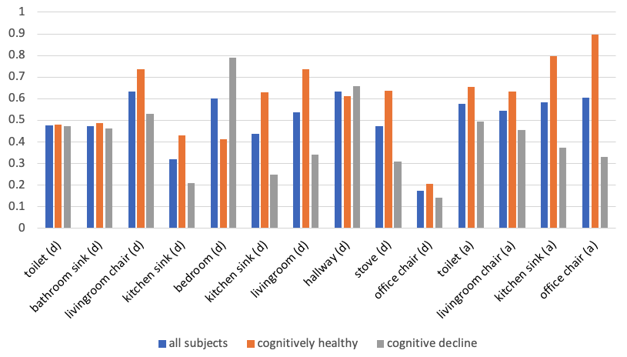
Inverse Reinforcement Learning (IRL) of Indoor Behavior – Results
preferences of all subjects
most great differences between two subgroups
less preferences of all subjects
Notes:
talk about the purpose of the experiments??
learned preference values of each feature
The figure shows preference values for all subjects, cognitively healthy and those with cognitive decline learned using the RRE-IRL algorithm.
Overall, the subjects, all of whom are older adults, show a preference for time spent in a favorite living room chair and in the hallway transitioning between regions of the home.
Much less of an influence on their routine is time spent in the office chair or at the kitchen sink.
The two population subgroups, cognitively healthy and cognitive decline, differ most greatly in terms of time spent
in the bedroom
at the kitchen sink and stove,
in the living room.
Subjects with cognitive decline show stronger preference for time in the bedroom, while cognitively healthy subjects exhibited preference for time in the living room and kitchen. Additionally, cognitively healthy subjects showed a stronger preference for overall activity in area of the monitored areas.

Slide 84
Inverse Reinforcement Learning (IRL) of Indoor Behavior – Conclusions
1. Indoor navigation can be described as a Markov decision process
2. Spatial and temporal features can be fused into one model
3. Indoor behavior strategy can be learned via IRL
4. Cognitively declined residents can be distinguished from healthy population

Slide 85
Papers covered
Analyzing Sensor-Based Individual and Population Behavior Patterns via Inverse Reinforcement Learning. Lin, B. and Cook, D.J., 2020. Sensors, 20(18), p.5207.
Deep PQR: Solving Inverse Reinforcement Learning using Anchor Actions Geng S, Nassif H, Manzanares C, Reppen M, and Sircar R International Conference on Machine Learning (ICML'20), Vienna, Austria, 2020.
Seeker: Real-Time Interactive Search Biswas A, Pham TT, Vogelsong M, Snyder B, and Nassif H Knowledge Discovery in Databases Conference (KDD'19), Anchorage, Alaska, pp. 2867-2875, 2019.
Notes:
First, they both leverage reward signals to inform recommendation, second, they were both led by interns.

Slide 86
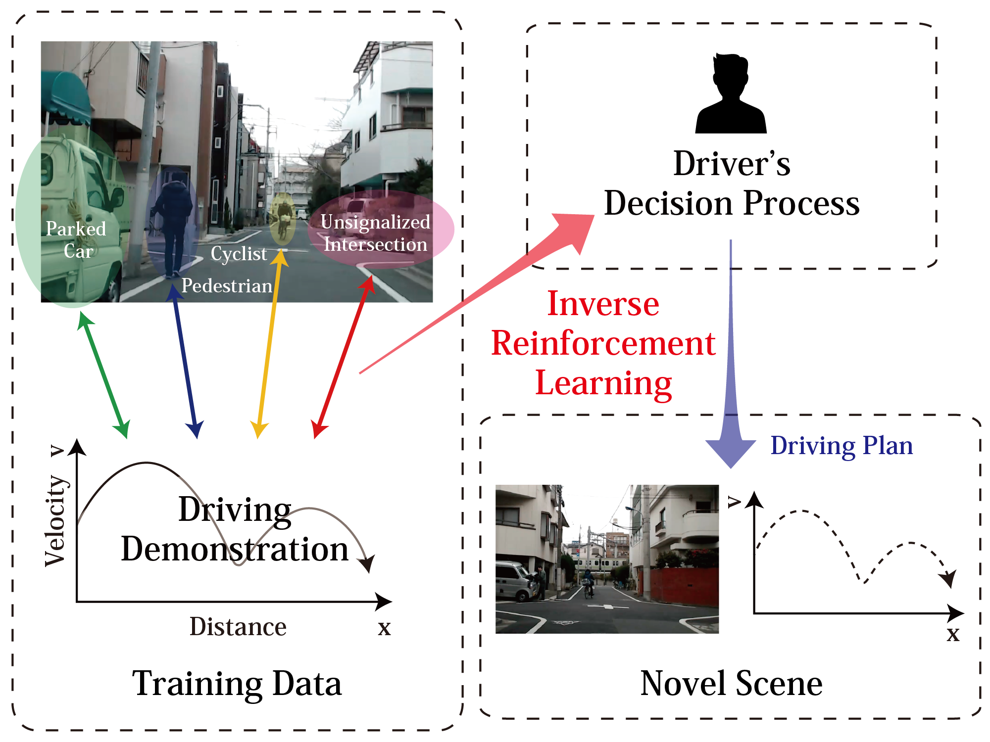
Inverse RL
Goal: Estimate the reward function of an agent given its decision-making history
Source: Shimosaka et al.
Notes:
recover a hidden reward function from observed agent demonstrations.
Common example is autonomous driving. U record a driver, apply IRL to uncover the driver’s decision process, and then apply it on novel scenes.

Slide 87
Identification issue
Unknown reward function reward(state, action)
Observed demonstrations
Optimal policy
r
IRL
Set of reward functions that explain demonstrations
Notes:
Recovering the reward is not as easy as it seems.
Given a reward function, an agent follows a policy and generates demonstrations. Based on demonstrations, IRL attempts to reverse engineer reward.
Different reward functions could explain the observed demonstrations, making it impossible to identify the true underlying reward function.
Identification issue

Slide 88

Anchor action
Key assumption!
Observed demonstrations
Known reward value for reward(state, action)
Optimal policy
r
PQR method
Naturally satisfied assumption: Do-nothing action, with 0 reward.
Notes:
We add the concept of an anchor action for each state: it is an action whose reward is known a priori
This is key. U may object: it is a restrictive assumption!
It turns out it is often naturally satisfied: the action of doing nothing, with 0 reward.
This assumption, coupled with our method allows exact identification.
IMP: to notice that we allow the Reward to depend on both s & a, not only on state, as other restrictive IRL methods assume
IRL assumes demonstrations result from an optimal policy. But it is impractical to assume agents always make the best choice.

Slide 89
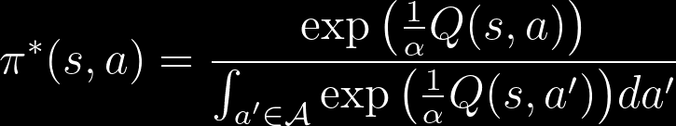
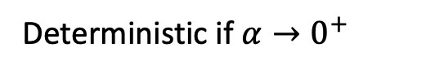
Energy based modeling
Assume agents maximize entropy-augmented long-term expected reward
Assume agents follow stochastic energy-based policy
Optimal policy:
Realistic behavior, agent likely (not guaranteed) to select better actions
Deterministic if $α→0^{+}$
Notes:
We remedy that by assuming agents maximize and follow energy based modeling. Under this paradigm, the optimal policy itself is stochastic (softmax).
Energy based modeling allows for randomness in agent behavior, and is more realistic. Note that other IRL methods require deterministic optimal policy.
U can recover the deterministic case by setting alpha = 0

Slide 90
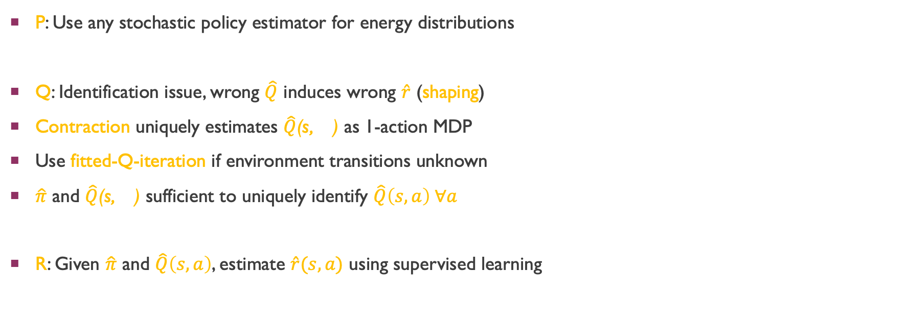
PQR: Policy, Q-function, Reward
P: Use any stochastic policy estimator for energy distributions
Q: Identification issue, wrong $\hat{Q}$ induces wrong $\hat{r}$ (shaping)
Contraction uniquely estimates $\hat{Q}$(s, ) as 1-action MDP
Use fitted-Q-iteration if environment transitions unknown
$\hat{π}$ and $\hat{Q}$(s, ) sufficient to uniquely identify $\hat{Q}\left(s,a\right) ∀a$
R: Given $\hat{π}$ and $\hat{Q}\left(s,a\right)$, estimate $\hat{r}(s,a)$ using supervised learning
Notes:
We call our method PQR, as we sequentially estimate Policy, Q-func, Reward. First step is to estimate policy using any stochastic policy estimator for energy distributions.
2nd step is Q-estimation. Here, we run into identification issue, as wrong Q induces wrong R (shaping)
We leverage anchor action to solve a fixed point contraction to uniquely estimate Q for anchor actions.
As transitions are usually unknown, we use a deep Q-network strategy, on which we apply the contraction repeatedly over demonstrations.
Now we have estimates of policy and Q-anchor, which are sufficient to identify Q for all state-action pairs.
Final step, using policy & Q-func estimates, we can recover reward using supervised learning
More notes:
FQI algorithm uses a deep function for QA(s), and implements the operator T by repeatedly leveraging the observed demonstrations. Because contraction expectation is over unknown transitions.
Solves it using Q-network strategy. Q is deep net. Apply expectation contraction operator repeatedly on Q-network. For expectation, get it from observed samples (run thru observed samples)
Same idea as auto-encoder (with X & Y changing)

Slide 91
Reward estimation
Theoretical guarantee: Estimation error is non-asymptotically upper bounded (under some assumptions)
Reward recovery MSE, for (5, 10, 20, 40) state feature dimensions
Notes:
We also provide non-asymptotic upper bounds on estimation error for PQR. Results show that it performs very well, as compared to other IRL methods.

Slide 92
Bandit Adaptive Recommendation
Biswas A, Pham TT, Vogelsong M, Snyder B, and Nassif H
KDD’19
Notes:
The bandit project was led by Ari, and published at KDD’19

Slide 93
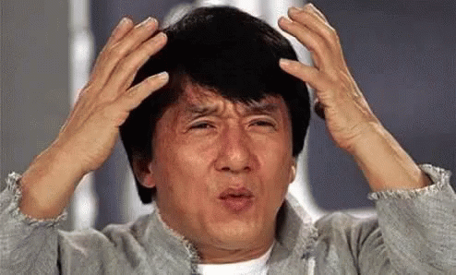
I have no idea how to describe this item!
Notes:
Suppose you want to search for an item, but have no idea how to describe it. Jackie chan

Slide 94
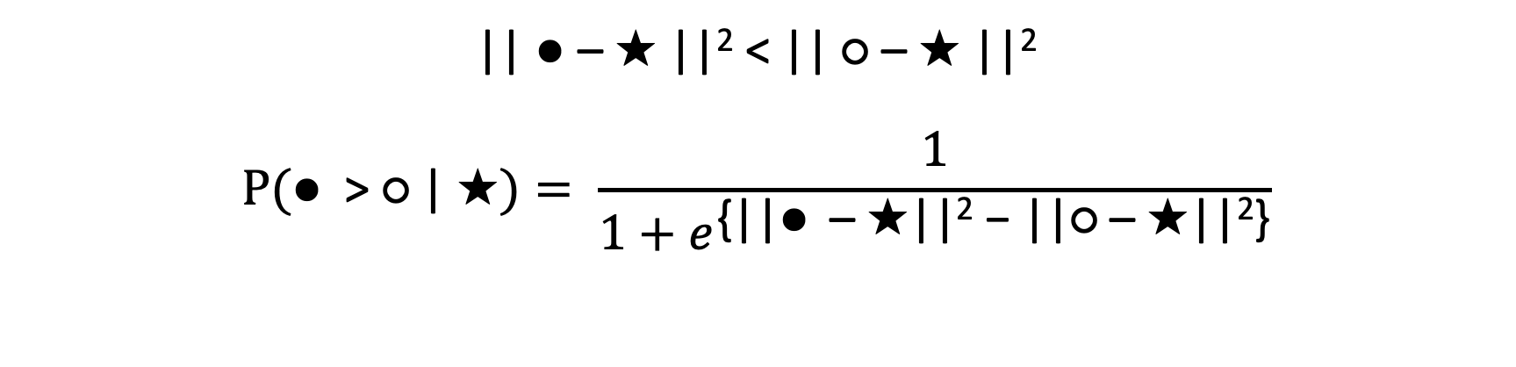
Able to give ordinal information
?
?
?
|| ● – ★ ||² < || ○ – ★ ||²
$$P(\text{●}\text{ > }\text{○ | ★})= \frac{1}{1+e^{\text{\{|}\text{|● – ★}\text{|}\text{|}\text{2} \text{−}\text{ ||○ – ★||}\text{2}\text{\}}}}$$
Likelihood of ★
Notes:
But if I give you two choices, you can tell me which one is closer to your target item.
In your feature space, distance between star and White ball is smaller than star and Black ball.
We can even mathematically represent the P of a user picking item A over B, given target.
If I observe a bunch of preference pairs, I can compute likelihood of an item being the target. Can then sample from it.

Slide 95
Adaptive real time search
Pointiness
Color gradient
Notes:
Here is a toy adaptive real time search application. Say our feature space has two dimensions. We need to interactively find the target in the user's mind.

Slide 96
Notes:
And here are our items. Target item is at top right with red arrow. System presents two options. User pick the closest. System recomputes likelihoods and shows two options. Shadowed items are not eliminated, they have reduced likelihood mass.

Slide 97
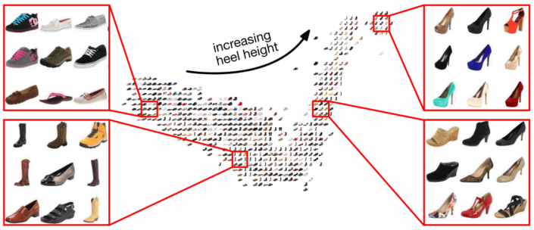
Apply in embedding space
Source: Belongie et al.
Notes:
In reality, we show a slate of recommendation, and apply algorithm in embedding space

Slide 98
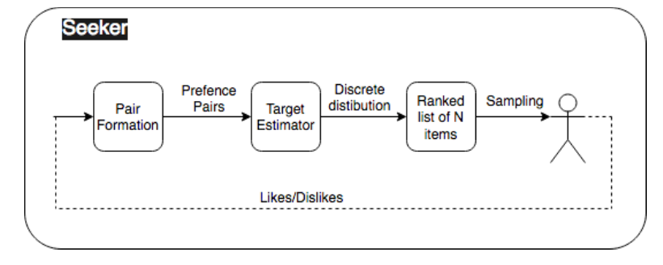
Trade-offs for speed
Fast point-wise target estimation
Very large catalog of items
Need fast real-time contextual bandits
Notes:
Our representation allows for a fast point-wise target estimation. But how do we choose the items to present to user in REAL TIME? V large catalogue, slow contextual bandit

Slide 99
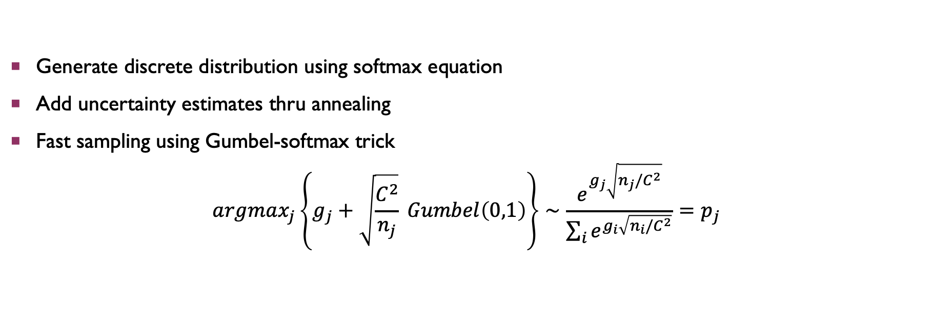
Sample from point estimates
Generate discrete distribution using softmax equation
Add uncertainty estimates thru annealing
Fast sampling using Gumbel-softmax trick
$$argmax_{j}\left\{g_{j}+\sqrt{\frac{C^{2}}{n_{j}}} Gumbel\left(0,1\right)\right\}∼\frac{e^{g_{j}\sqrt{n_{j}/C^{2}}}}{\sum_{i}{e^{g_{i}\sqrt{n_{i}/C^{2}}}}}=p_{j}$$
Likelihood of ★, pointwise estimate
Sample once
Recover softmax distribution
# of interactions with item j
Notes:
[READ] We get contextual TS bandit behavior, using fast non-Bayesian non-contextual techniques

Slide 100
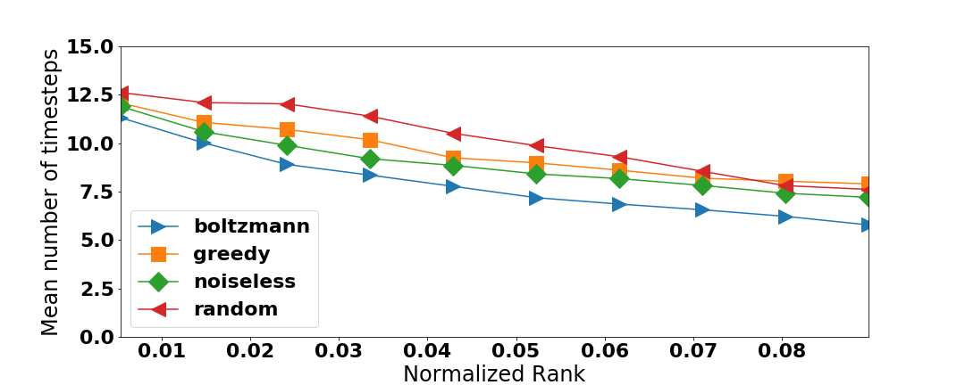
Boltzmann (softmax) bandit

Slide 101
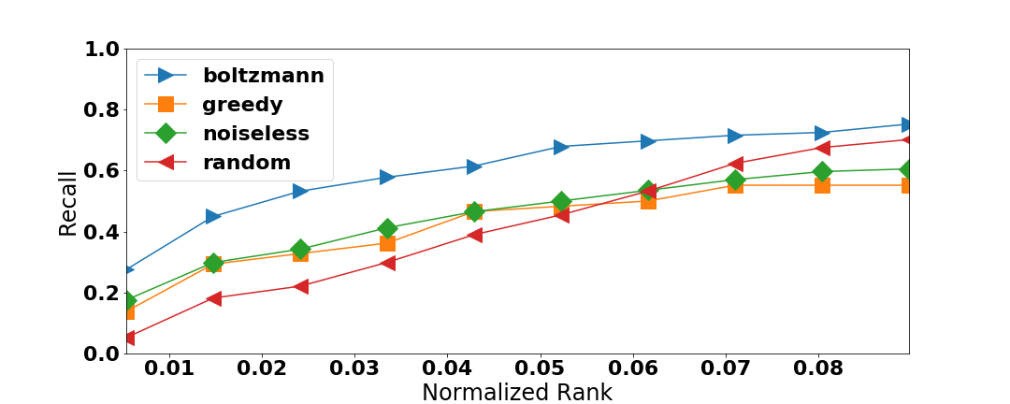
Boltzmann (softmax) bandit

Slide 102
Part I Apprenticeship learning via inverse reinforcement learning

Slide 103
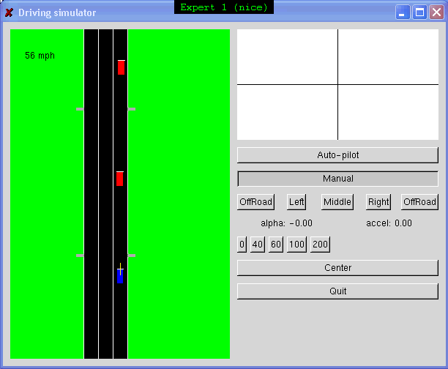
Motivation
Reinforcement learning (RL) gives powerful tools for solving MDPs. It can be difficult to specify the reward function. Example: Highway driving.
Notes:
RL gives powerful tools for solving MDPs. The reward function is a key part of the specification of the MDP and the solution of the MDP is strongly dependent on the reward function. However, in practice it can be difficult to specify the reward function and thus it might take a lot of manual tweaking of the reward to obtain the desired behavior. Consider, for example, the task of driving. Even though … can drive competently, it is not easy to write down a specific reward function.
When driving, we typically trade off many different desiderata, such as maintaining safe following distance, keeping away from the curb, staying far from any pedestrians, maintaining a reasonable speed, perhaps a slight preference for driving in the middle lane, not changing lanes too often, and so on . . . . To specify a reward function for the driving task, we would have
to assign a set of weights stating exactly how we would like to trade of these different factors. And although I feel a competent driver, I don’t think it is easy to write down a reward function that corresponds exactly to my driving style.
Although specifying the reward function might be difficult, it is fairly easy to demonstrate a desired driving style. More generally for other tasks, we might have access to an expert demonstrating good performance on the task at hand. It would be interesting if we could use the expert demonstrations instead of requiring the explicit specification of a reward function to learn a controller.
Consider the concrete example of highway driving. Here is a video of me demonstrating a good driving behavior, where I am controlling the blue car. It would be interesting if we could learn a controller for the car from this demonstration w/o needing to specify a reward function.

Slide 104
Apprenticeship Learning
Learning from observing an expert.
Previous work:
Learn to predict expert’s actions as a function of states.
Usually lacks strong performance guarantees.
(E.g.,. Pomerleau, 1989; Sammut et al., 1992; Kuniyoshi et al., 1994; Demiris & Hayes, 1994; Amit & Mataric, 2002; Atkeson & Schaal, 1997; …)
Our approach:
Based on inverse reinforcement learning (Ng & Russell, 2000).
Returns policy with performance as good as the expert as measured according to the expert’s unknown reward function.
Notes:
The example of learning to drive a car from expert demonstrations might remind some people of ALVINN. Where supervised learning (in particular a neural network) was used to learn state-action mapping directly, with some very good success on the driving task. These approaches typically require some careful engineering to obtain the desired behavior, and often lack guarantees.
2 ways to teach 16year old (mimic or let them figure out your trade-off)
‘and for that matter unknowable’
We do not need to specify a reward function; but can automatically figure out information about the reward function that s/he was implicitly optimizing; then use that to learn to perform the task ourselves.
(eg. How to demonstrate actions for undesired states required some careful engineering with ALVINN.)

Slide 105
Algorithm
For t = 1,2,…
Inverse RL step:
Estimate expert’s reward function R(s)= w^{T}φ(s) such that under R(s) the expert performs better than all previously found policies {π_{i}}.
RL step:
Compute optimal policy π_{t} for
the estimated reward weights w.
Notes:
Convey intuition about what the algorithm is doing. Find reward that makes teacher look much better; and then hypotesize that reward and find the policy.
The intuition behind the algorithm, is that the set of policies generated gets closer (in some sense) to the expert at every iteration.
RL black box.
Inverse RL: explain the details now.

Slide 106
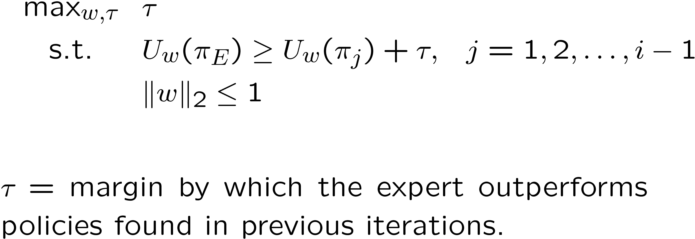
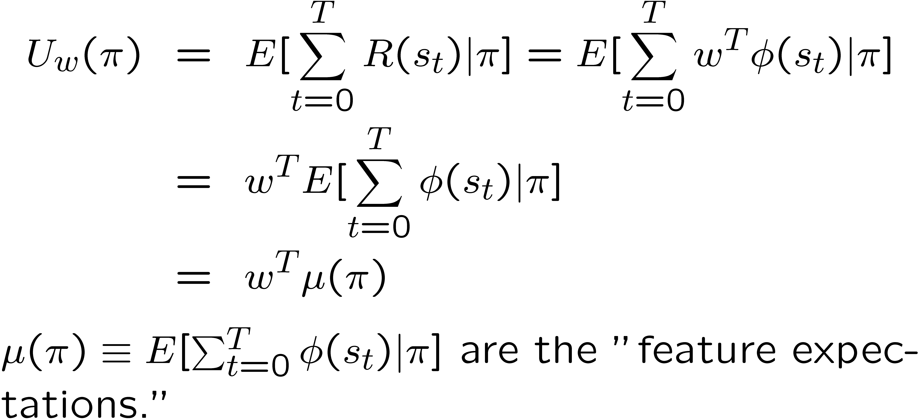
Algorithm: Inverse RL step

Slide 107
Feature Expectation Closeness and Performance
If we can find a policy π such that
||μ(π_{E}) - μ(π)||₂ ≤ ε,
then for any underlying reward R*(s) =w*^{T}φ(s),
we have that
|U_{w*}(π_{E}) - U_{w*}(π)| = |w*^{T} μ(π_{E}) - w*^{T} μ(π)|
≤ ||w*||₂ ||μ(π_{E}) - μ(π)||₂
≤ ε.
Notes:
Let’s now look at how we could get performance guarantees, although the reward function is unknown. The key is that, if we can find a policy that is \epsilon close to the expert in feature expectations, then no matter what the underlying, unknown, reward function R* is, that policy will have performance \epsilon close to the expert’s performance as measure w.r.t. the unknown reward function. This is easily seen as follows.
Going back to our algorithm, at every iteration it finds a policy closer to the expert in terms of feature expectations as follows. I will now illustrate this intuition graphically.
In the inverse RL step it finds the direction in feature space for which the expert is mostly separated from the previously found policies. In the RL step, it finds a policy which is optimal w.r.t. this estimated reward, which brings it closer to the expert, again, in feature expectation space.
Motivation for algorithm. --- get closer in \mu;

Slide 108
Theoretical Results: Convergence
Theorem. Let an MDP (without reward function), a k-dimensional feature vector φ and the expert’s feature expectations μ(π_{E}) be given. Then after at most
kT²/ε²
iterations, the algorithm outputs a policy π that performs nearly as well as the expert, as evaluated on the unknown reward function R*(s)=w*^{T}φ(s), i.e.,
U_{w*}(π) ≥ U_{w*}(π_{E}) - ε.
Notes:
Our algorithm does not require the expert to be succesfully optimizing R* (say more casually, no emphasis)
Transition: here assume \mu_E known, in practice need to estimate from samples. This is a technicalty which can be dealt with easily, and we need only polynomial number of samples.

Slide 109
Gridworld Experiments
Reward function is piecewise constant over small regions.
Features φ for IRL are these small regions.
128x128 grid,
small regions of size 16x16.
Notes:
128x128 gridworld, 4 actions (compass directions), actions succeed with 70% chance (otherwise random among other neighboring squares) Non-overlapping regions of 16x16 cells are the features. A small number have non-zero (positive) rewards. Expert optimal w.r.t. some weights w*

Slide 110
Gridworld Experiments

Slide 111
Gridworld Experiments

Slide 112
Gridworld Experiments

Slide 113
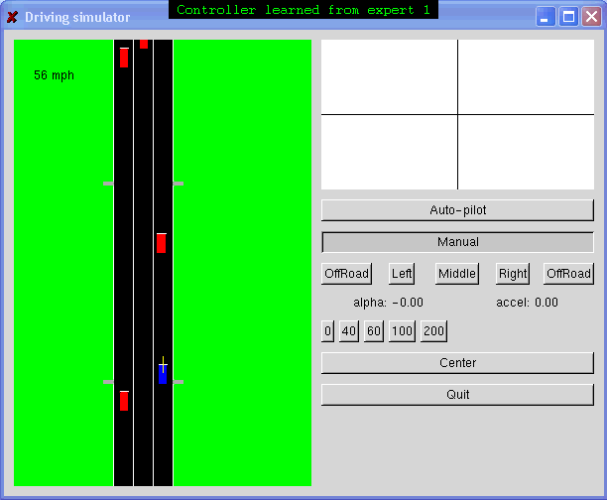
Case study: Highway driving
Input: Driving demonstration
Output: Learned behavior
The only input to the learning algorithm was the driving demonstration (left panel). No reward function was provided.
Notes:
Explain features for driving irl.
Duplicating actions → less accurate duplication of \mu_E;
Policy simplicity ←> reward simplicity

Slide 114
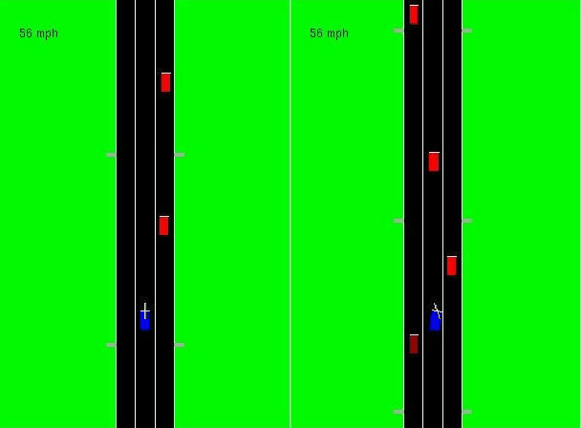
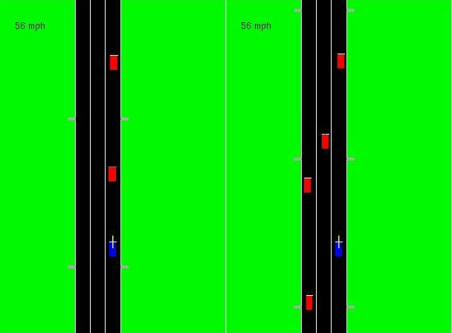
More driving examples
In each video, the left sub-panel shows a demonstration of a different driving “style”, and the right sub-panel shows the behavior learned from watching the demonstration.
Notes:
Notice that in several examples the algorithm has managed to capture the same qualitative driving style for a number of different circumstances.

Slide 115
Conclusions for part I
Our algorithm returns a policy with performance as good as the expert as evaluated according to the expert’s unknown reward function.
Algorithm is guaranteed to converge in poly(k,1/ε) iterations.
The algorithm exploits reward “simplicity” (vs. policy “simplicity” in previous approaches).
Notes:
Red??

Slide 116
Part II Apprenticeship learning for learning the transition model

Slide 117
Learning the dynamics model P_{sa} from data
Dynamics
Model
Estimate P_{sa} from data
P_{sa}
Reward
Function
R
Reinforcement
Learning
Control policy π
Notes:
Consider the problem of controlling a system with unknown dynamics to perform a specific task we have in mind.
To do this, we could model our problem as a Markov Decision Process and then use an RL algorithm to efficiently solve the MDP.
The specification of the MDP consists of the set of states, set of actions, the transition probabilities, the discount factor, initial state distribution, reward function.
Goal: design a controller for a system.
Standard approach: model the problem as a Markov Decision Process (MDP).
Use an RL algorithm to find the controller.
Specifying the MDP can be difficult, in particular the reward function R and transition probabilities Psa.
Expert demonstrations can be used
as a substitute for specifying the reward function.
for efficiently learning a transition model.

Slide 118
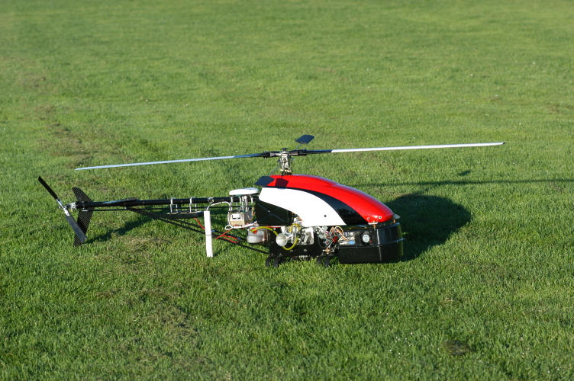
Transition model
Consider the problem of controlling a complicated system like a helicopter.
No models are available that specify the dynamics accurately as a function of the helicopter’s specifications.
So we need to estimate the dynamics from data.
Have to collect enough data to model all relevant parts of the flight envelop.

Slide 119
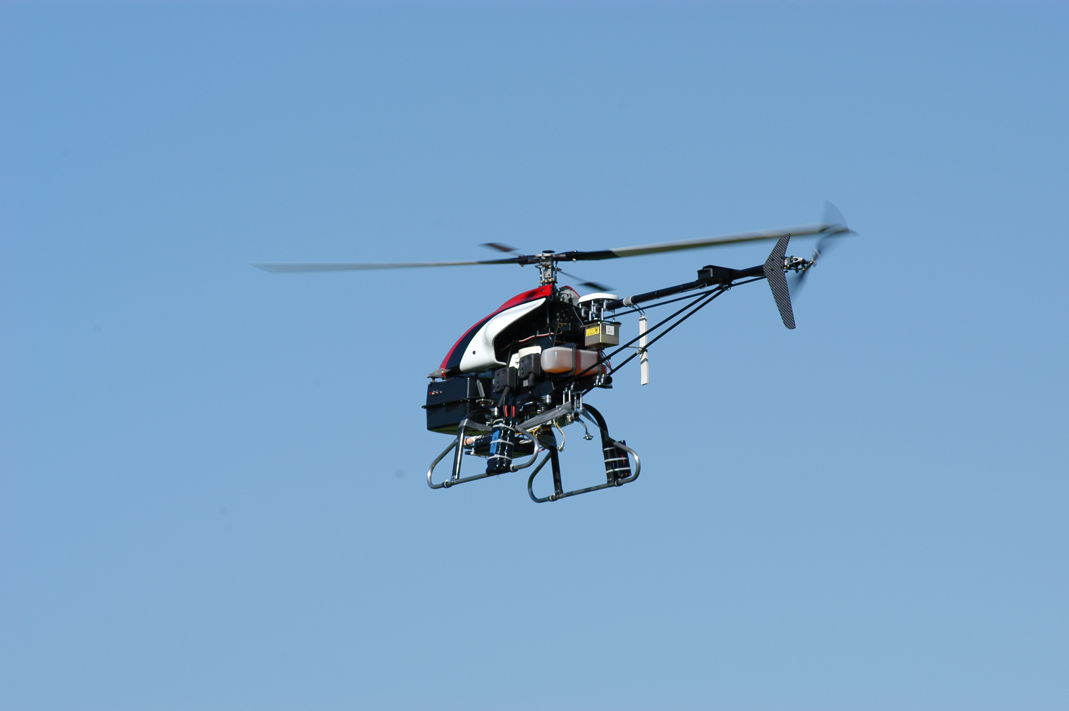
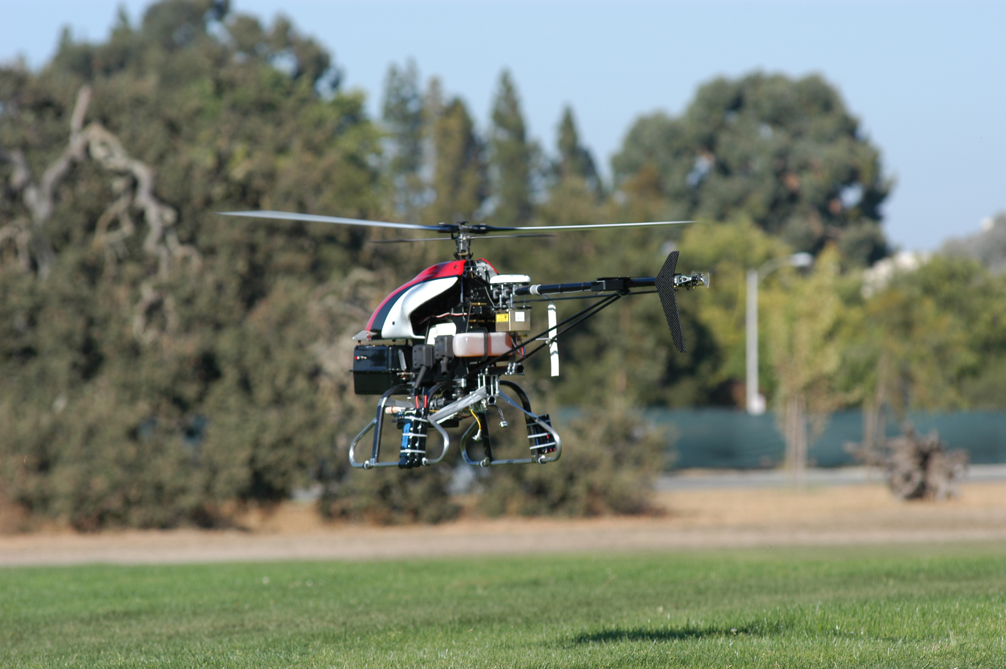
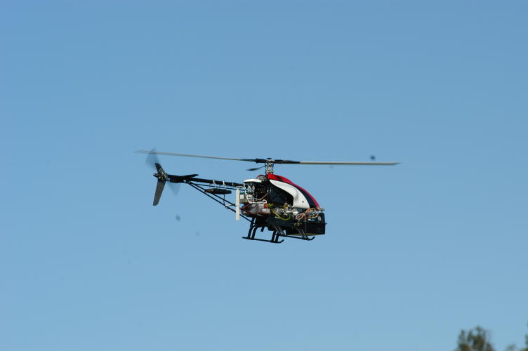
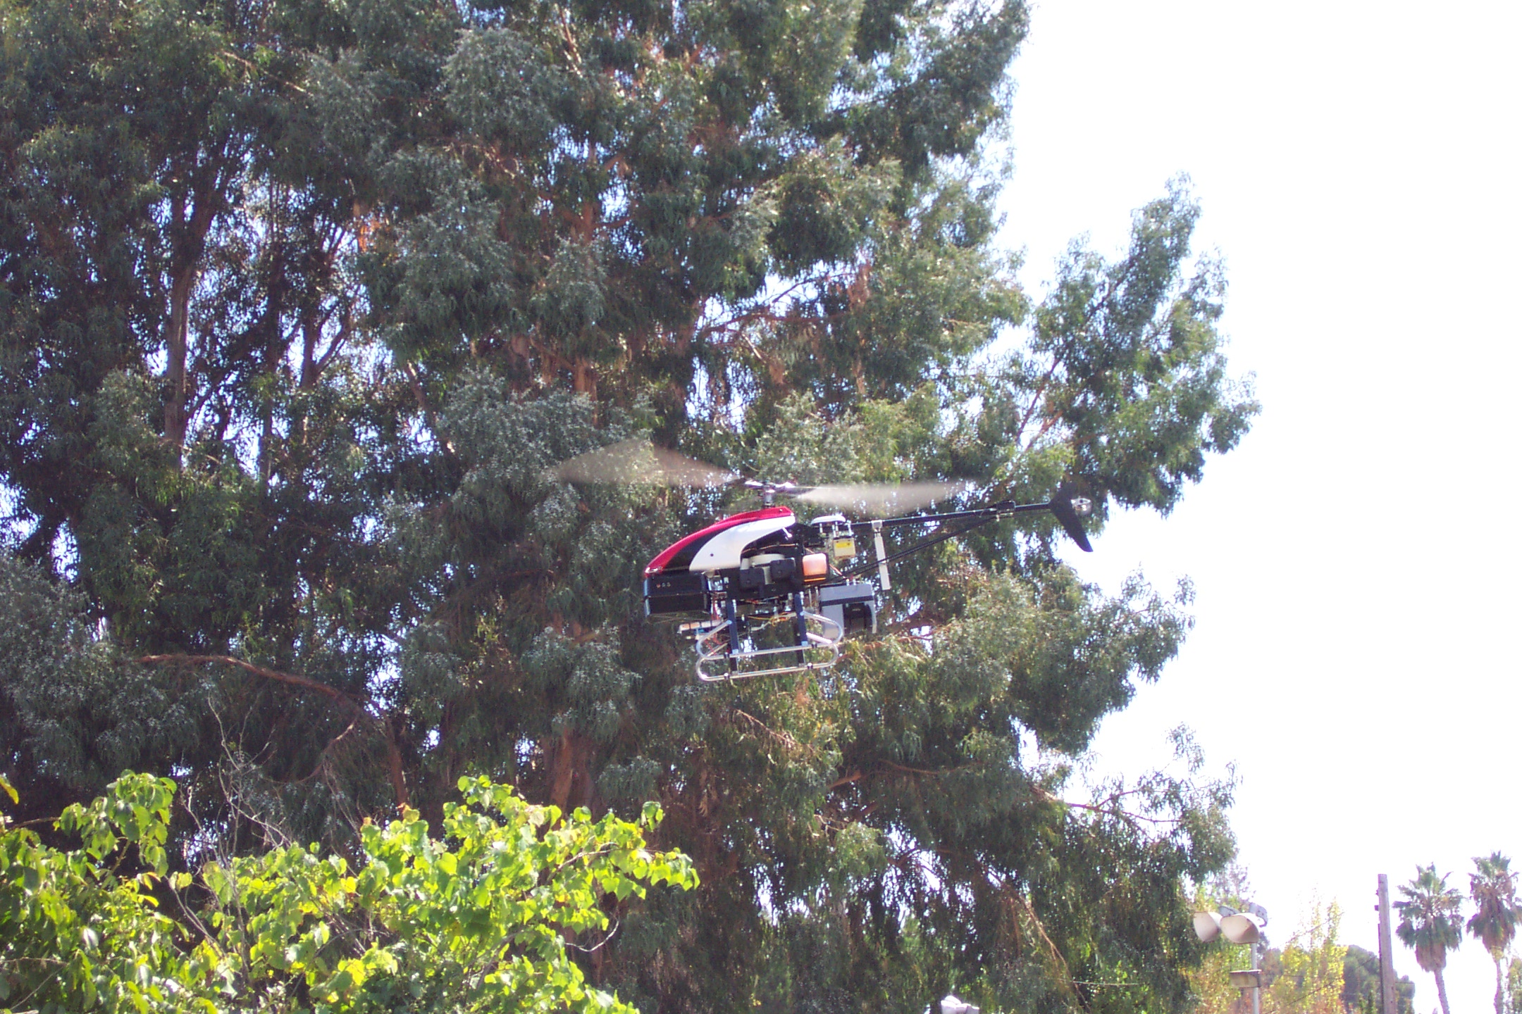
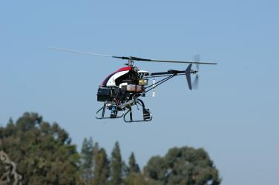
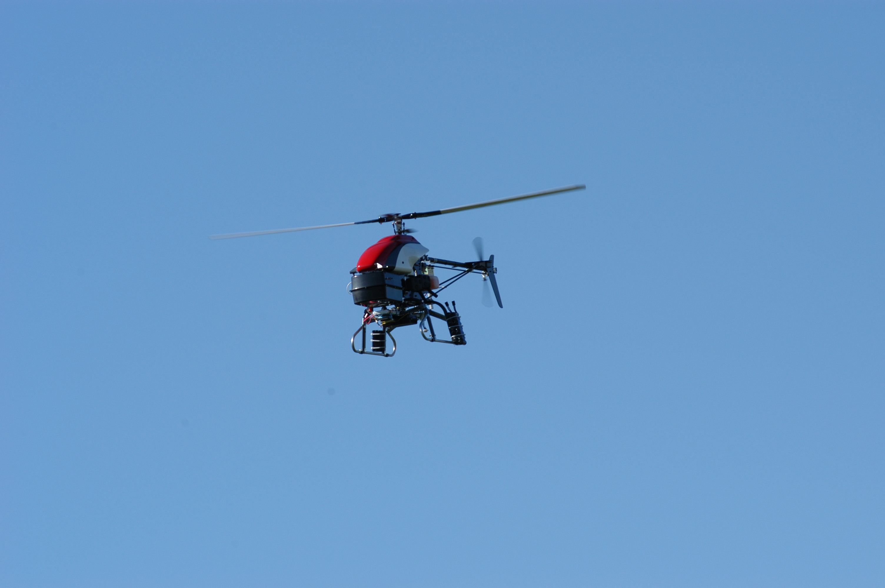

Collecting data to learn dynamical model
State-of-the-art: E³ algorithm (Kearns and Singh, 2002)
Have good
model of
dynamics?
YES
NO
“Exploit”
“Explore”
Notes:
Explicitly say what explore and exploit are.

Slide 120
Learning the dynamics
Expert human pilot flight
Autonomous flight
Dynamics
Model
Learn P_{sa}
Learn P_{sa}
P_{sa}
(a₁, s₁, a₂, s₂, a₃, s₃, ….)
(a₁, s₁, a₂, s₂, a₃, s₃, ….)
Reinforcement
Learning
Reward
Function
R
Control policy π
Notes:
If access to an expert, we can follow the following much more palatable procedure …
Just describe algorithm here. // Until policy that flies the helicopter well.

Slide 121
Apprenticeship learning of model
Theorem. Suppose that we obtain m = O(poly(S, A, T, 1/ε)) examples from a human expert demonstrating the task. Then after a polynomial number N of iterations of testing/re-learning, with high probability, we will obtain a policy π whose performance is comparable to the expert’s:
U(π) ≥ U(π_{E}) - ε
Thus, so long as a demonstration is available, it isn’t necessary to explicitly explore.

Slide 122
Proof idea
From initial pilot demonstrations, our model/simulator P_{sa} will be accurate for the part of the flight envelop (s,a) visited by the pilot.
Our model/simulator will correctly predict the helicopter’s behavior under the pilot’s policy π_{E}.
Consequently, there is at least one policy (namely π_{E}) that looks like it’s able to fly the helicopter well in our simulation.
Thus, each time we solve the MDP using the current simulator P_{sa}, we will find a policy that successfully flies the helicopter according to P_{sa.}
If, on the actual helicopter, this policy fails to fly the helicopter---despite the model P_{sa} predicting that it should---then it must be visiting parts of the flight envelop that the model is failing to accurately model.
Hence, this gives useful training data to model new parts of the flight envelop.
Notes:
At every iteration, we find a policy that flies the helicopter in simulation. If it does not, it means the helicopter visits states for which the simulator is inaccurate. So by collecting data under this policy, we are guaranteed to get a better model for this unknown part of the state space/flight envelop.

Slide 123
Conclusions

Slide 124
Conclusions
Dynamics
Model
Given an initial demonstration, there is no need to explicitly explore the state/action space. Even if you repeatedly “exploit” (use your best policy), you will collect enough data to learn a sufficiently accurate dynamical model to carry out your control task.
P_{sa}
Reinforcement
Learning
Reward
Function
R
Control policy π
Given expert demonstrations, our inverse RL algorithm returns a policy with performance as good as the expert as evaluated according to the expert’s unknown reward function.

Slide 125
Passive Learning
Simplified task
You don’t know the transitions T(s,a,s’)
You don’t know the rewards R(s,a,s’)
You are given a policy π(s)
Goal: learn the state values
… what policy evaluation did
In this case:
Learner “along for the ride”
No choice about what actions to take
Just execute the policy and learn from experience
We’ll get to the active case soon
This is NOT offline planning! You actually take actions in the world and see what happens…

Slide 126
Model-Based Learning
Idea:
Learn the model empirically through experience
Solve for values as if the learned model were correct
Simple empirical model learning
Count outcomes for each s,a
Normalize to give estimate of T(s,a,s’)
Discover R(s,a,s’) when we experience (s,a,s’)
Solving the MDP with the learned model
Iterative policy evaluation, for example
s
π(s)
s, π(s)
s, π(s),s’
s’

Slide 127

Sample-Based Policy Evaluation?
Who needs T and R? Approximate the expectation with samples (drawn from T!)
s
π(s)
s, π(s)
s, π(s),s’
s₂’
s₁’
s₃’
Almost! But we only actually make progress when we move to i+1.

Slide 128
Temporal-Difference Learning
s
π(s)
Big idea: learn from every experience!
Update V(s) each time we experience (s,a,s’,r)
Likely s’ will contribute updates more often
Temporal difference learning
Policy still fixed!
Move values toward value of whatever successor occurs: running average!
s, π(s)
s’
Sample of V(s):
Update to V(s):
Same update:

Slide 129

Exponential Moving Average
Exponential moving average
Makes recent samples more important
Forgets about the past (distant past values were wrong anyway)
Easy to compute from the running average
Decreasing learning rate can give converging averages

Slide 130


Problems with TD Value Learning
TD value leaning is a model-free way to do policy evaluation
However, if we want to turn values into a (new) policy, we’re sunk:
Idea: learn Q-values directly
Makes action selection model-free too!
s
a
s, a
s,a,s’
s’

Slide 131
Active Learning
Full reinforcement learning
You don’t know the transitions T(s,a,s’)
You don’t know the rewards R(s,a,s’)
You can choose any actions you like
Goal: learn the optimal policy
… what value iteration did!
In this case:
Learner makes choices!
Fundamental tradeoff: exploration vs. exploitation
This is NOT offline planning! You actually take actions in the world and find out what happens…

Slide 132


Model free learning: Q-Learning
Q-Learning: sample-based Q-value iteration
Learn Q*(s,a) values
Receive a sample (s,a,s’,r)
Consider your old estimate:
Consider your new sample estimate:
Incorporate the new estimate into a running average:

Slide 133
Q-Learning Properties
Amazing result: Q-learning converges to optimal policy
If you explore enough
If you make the learning rate small enough
… but not decrease it too quickly!
Basically doesn’t matter how you select actions (!)
Neat property: off-policy learning
learn optimal policy without following it (some caveats)
S |  |  |  |  |  | E
S |  |  |  |  |  | E

Slide 134
Exploration / Exploitation
Several schemes for forcing exploration
Simplest: random actions (ε greedy)
Every time step, flip a coin
With probability ε, act randomly
With probability 1-ε, act according to current policy
Problems with random actions?
You do explore the space, but keep thrashing around once learning is done
One solution: lower ε over time
Another solution: exploration functions

Slide 135

Q-Learning
Q-learning produces tables of q-values:

Slide 136
Learning from demonstration
Humans are working models of control and policy learning
Leverage human tutelage and/or performance to build robot controllers
Can involve supervised, unsupervised and/or reinforcement learning
Video

Slide 139
The Story So Far: MDPs and RL
Things we know how to do:
Techniques:
If we know the MDP
Compute V*, Q*, π* exactly
Evaluate a fixed policy π
If we don’t know the MDP
We can estimate the MDP then solve
We can estimate V for a fixed policy π
We can estimate Q*(s,a) for the optimal policy while executing an exploration policy
Model-based DPs
Value and policy Iteration
Policy evaluation
Model-based RL
Model-free RL:
Value learning
Q-learning

Slide 140
Q-Learning
In realistic situations, we cannot possibly learn about every single state!
Too many states to visit them all in training
Too many states to hold the q-tables in memory
Instead, we want to generalize:
Learn about some small number of training states from experience
Generalize that experience to new, similar states
This is a fundamental idea in machine learning, and we’ll see it over and over again

Slide 141

Inverse Reinforcement Learning (IRL) - Definitions
0.7
A Markov Decision Process (MDP) model contains:
A set of possible states S
A set of possible actions A
A real valued reward function R(s, a)
A transition matrix P
0.2
Notes:
Green: states
Red arrows: actions
Reward based on each action in a state
0.7, 0.2: probabilities in a transition matrix

Slide 142
Inverse Reinforcement Learning (IRL) - RL
Reinforcement Learning (RL):

Slide 143
Inverse Reinforcement Learning (IRL) – RL v.s. IRL
Notes:
Unlike other IRL research, which learns from imitation to recreate expert moves, we learn from mimicry to capture and analyze a model of human behavior.
To model human behavior from ambient sensor data, we propose an approach that is based on inverse reinforcement learning (IRL).
IRL is a machine learning technique that mimics observed behavior. In this study, our proposed algorithm mimics the behavior of a smart home resident based on sensor-observed navigation patterns within a home environment.
Unlike other IRL research, which learns from imitation to recreate expert moves, we learn from mimicry to capture and analyze a model of human behavior.
Note: the significance of learning the rewards: learn the preference differences on different subgroups.

Slide 144
Inverse Reinforcement Learning (IRL) of Indoor Behavior – Navigation
d_toilet | d_bathroom_sink | d_livingroom_chair | d_kitchen_sink
d_bedroom | d_kitchen | d_livingroom | d_hallway
d_stove | d_office_chair | o_toilet | o_livingroom_chair
o_kitchen_sink | o_office_chair
Notes:
Table is the features:
feature names prefixed by “d : the duration that the resident stays at a location
feature names prefixed by “o_”: the overall activity/movement level at a location

Slide 145
Inverse Reinforcement Learning (IRL) of Indoor Behavior – Algorithm
:
Notes:
IRL is an optimization problem. To solve it, there are two steps:
1. introducing Lagrange multipliers to have a Lagrangian
2. solving a Lagrange dual function g
Note: \hat{\partial} g(\theta) is the gradient of the dual function g.
\hat{\partial} g(\theta) : gradient estimation based on trajectories.
1. \hat{u_i}: feature expectations
2. A_tran: join probability of the actions executed on the states in trajectories.

Slide 146
Data Types

